Slide 1





AI-Driven Automation of Unit Testing & Peer Code Review
Enterprise IT Development Efficiency Enhancement

Slide 2


What is Unit Testing and Peer Code Review?
Testing small parts of code to make sure they work correctly
Team members check each other's code to find mistakes and improve quality..
Why AI in Testing?
Saves time by automating repetitive tasks.
Makes testing faster and more reliable.

Slide 3


Problem Statement
Current Challenges:
Manual unit testing is time-consuming and prone to human error.
Traditional peer code reviews may overlook subtle issues, affecting code quality.
Ensuring comprehensive test coverage is difficult in large codebases.
Key Question :
How can AI be integrated into unit testing and peer code review processes to improve efficiency, accuracy, and code quality while reducing human effort?

Slide 4

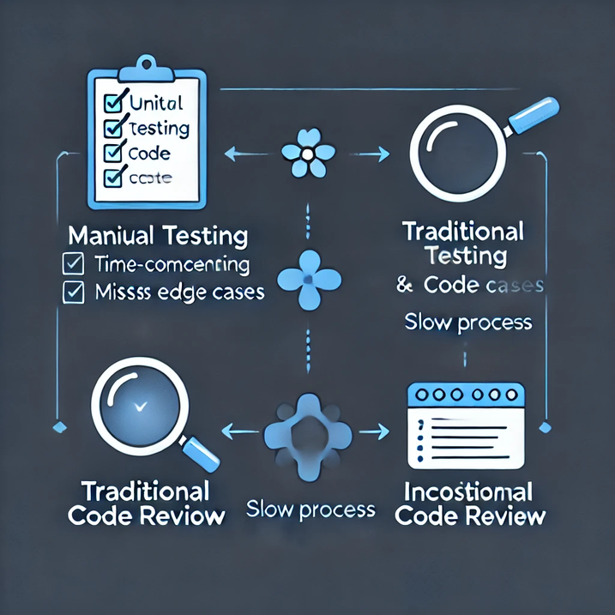

Existing Solutions
Manual Testing:
Requires human effort, slow, and error prone.
Automated Testing:
Faster but requires humans to write scripts.
Fails to adapt to changes in the codebase dynamically.
Gaps in Existing Solutions:
No mechanism for self-learning.
Lacks the ability to detect unexpected edge cases automatically.

Slide 5
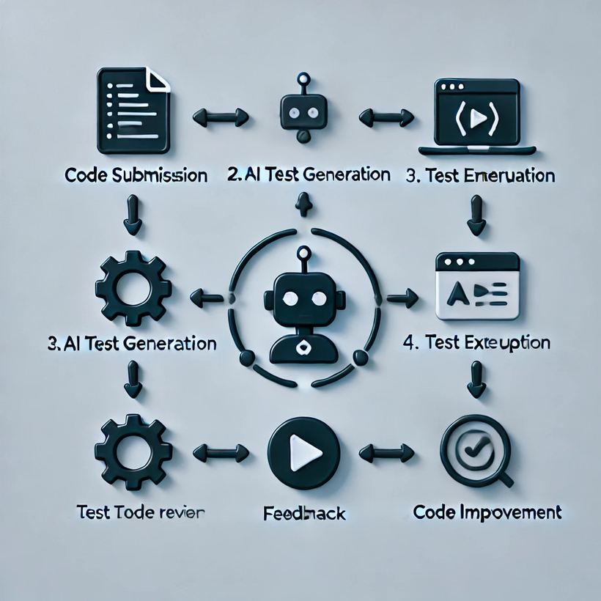
Proposed Solution
Work Flow
Integrating AI into Testing:
Leverage machine learning algorithms to improve test case generation, bug prediction, and code analysis.
How It Works:
AI scans the codebase to identify potential problem areas.
Auto-generates test cases and executes them.
Predicts failure points and suggests fixes.
Continuously learns and improves with every code change.

Slide 6

Applications
Continuous Integration/Continuous Deployment (CI/CD):
AI ensures new code merges don’t break existing features.
Security Testing:
AI detects vulnerabilities and prevents breaches.
Performance Testing:
Simulates high user loads and identifies performance bottlenecks.
Mobile App Testing:
Ensures app compatibility across devices and operating systems.

Slide 7

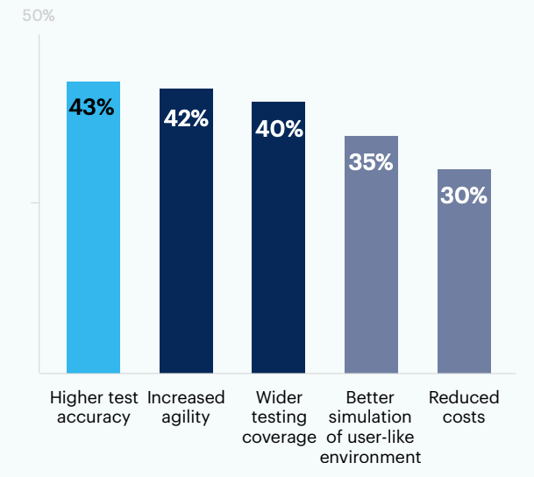
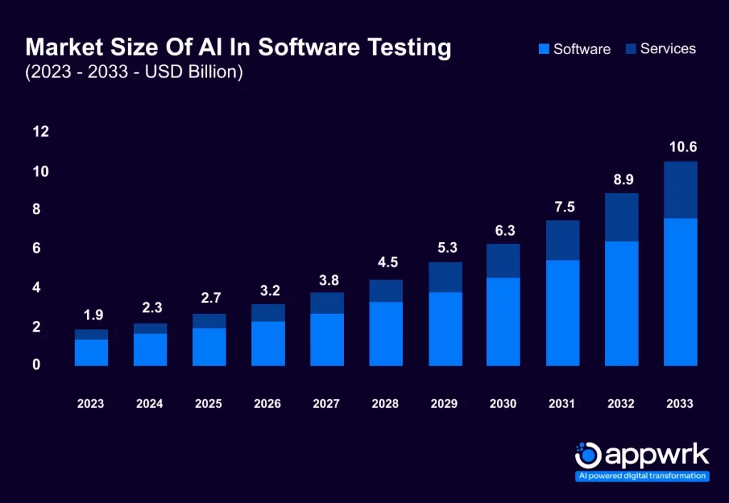
Research Analysis
Impact of AI on Software Testing Efficiency
Market Growth of AI-Powered Software Testing Solutions (2023–2033)

Slide 8
Challenges
Data Dependency: AI requires diverse datasets to train effectively.
False Positives/Negatives: AI may misinterpret some scenarios.
Human Oversight: AI can assist but not replace testers fully.
Complex Scenarios: AI struggles with unique coding practices and unanticipated edge cases.
Future Scope
Self-Adaptive AI: Models that continuously improve by learning from new code.
AI-Driven Test Optimization: Prioritize critical test cases automatically.
Fully Autonomous Testing Pipelines: Minimize human involvement.
Human-AI Collaboration: AI assists testers rather than replacing them.

Slide 9
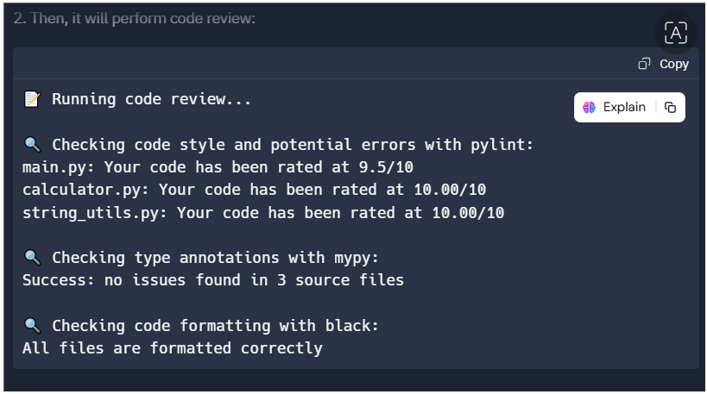
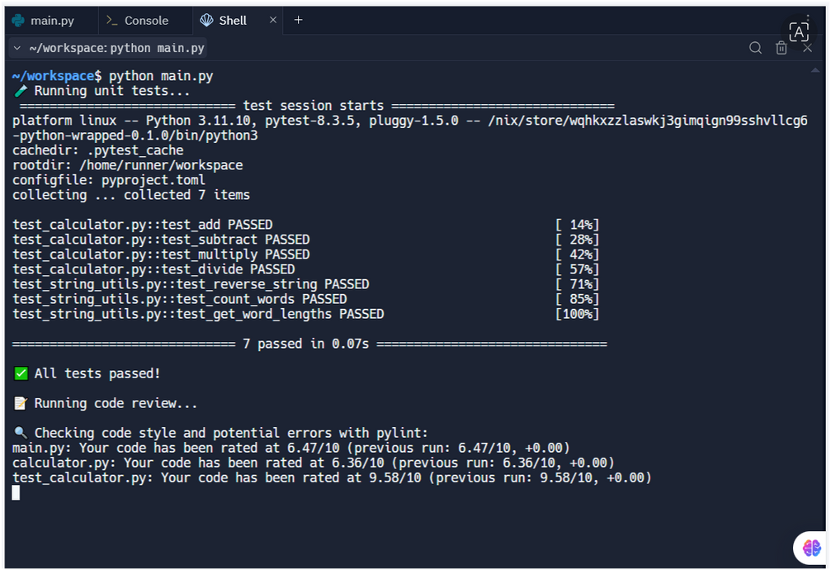
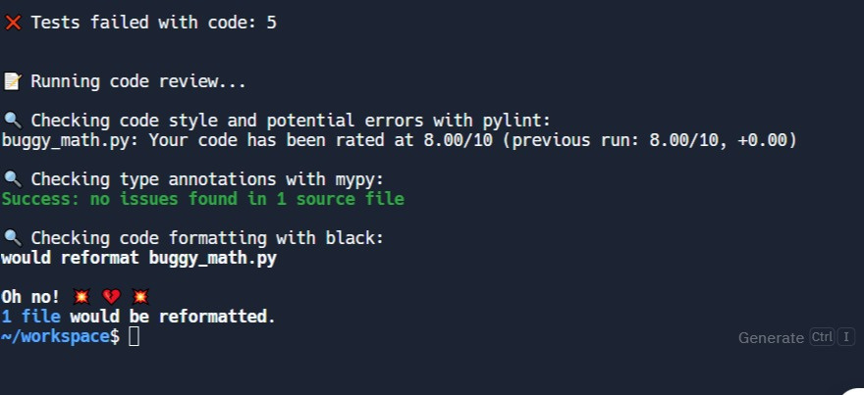

AI-Powered Testing and Code Review
AI runs automated tests for calculator and string tools.
Detects passed or failed tests instantly.
Analyzes code quality and provides feedback.

Slide 10
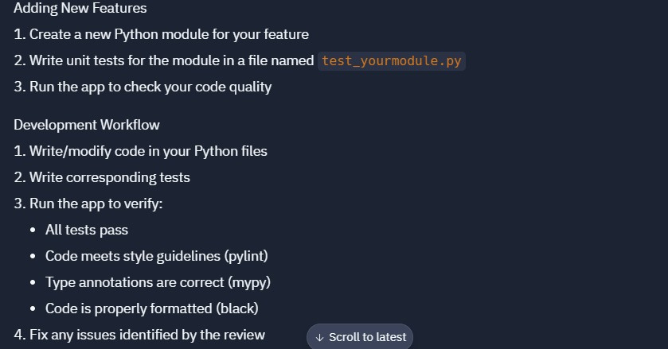
Adding Features

Slide 11
Conclusion
AI integration in testing addresses key challenges:
Reduces human effort and enhances accuracy.
Speeds up release cycles and improves software quality.
Future Vision:
AI will assist testers rather than replace them, creating a smarter testing environment that balances automation and human insight.

Slide 12

Thank You!
Any Queries ?

